Slide 1
Session 5.1 Advanced SQL 1- Subqueries
IN705 Databases 3 - 2018
Notes:
We’re going to take this quite slowly, because people find it very difficult
You will need paper and pencil

Slide 2
Definition
Standard query SELECT-FROM-WHERE...
May occur as a substatement of another query:
In the WHERE clause
In the HAVING clause
In the FROM clause
In the SELECT list
The subquery is evaluated first, and the record set it returns is used to process the main query.
Notes:
Reading
You are all familiar with the standard SELECT-FROM-WHERE (with optional GROUP BY and HAVING) construct that returns a set of records from the database
In SQL, this construct may occur as a subcomponent of another query
Subqueries can be difficult to understand. Partially this is because, for them to really make sense, we have to be thinking about SQL as what it is – a set manipulation language.
Problems in SQL are solved by dealing with operations on sets, not by procedural instructions, as in C or Java.
If you try to think about SQL as a procedural language, it is harder.

Slide 3
Subqueries in the WHERE
Basic (without subquery):
SELECT columns
FROM tables
WHERE some value is related to some other value
SELECT ownerName
FROM ownerTable
WHERE petType = ‘rabbit’
Notes:
Here’s the usual WHERE

Slide 4
Subqueries in the WHERE
With a subquery:
SELECT columns
FROM tables
WHERE some value is related to some set operation result
Notes:
The query starts out as normal, but instead of comparing WHERE to a single value, you want to compare it to some set operation result that can most easily be gotten by doing a SELECT statement.
So, let’s think about things that you can only do with a SELECT statement.
You can get a group of things (a record set), and we will see examples of that.
But the one thing you have to do a SELECT for is to use an aggregate – like a max, min, count or average
Aggregates operate over a set of records; you can’t aggregate without a set of records
So if you want to use an aggregate in the WHERE clause, you’ll have to stuff a SELECT statement in there as a subquery.

Slide 5
Subqueries in the WHERE
Comparing against an aggregate
List all the instances that are “less than average on some field”
Find the record that has “the maximum on some field”
Notes:
The query starts out as normal, but instead of comparing WHERE to a single value, you want to compare it to some set result that can most easily be gotten by doing a SELECT statement

Slide 6
Subqueries in the WHERE
Comparing against an aggregate
Plant ID | Plant Name | Optimal Sunlight Percentage | Optimal Moisture Level | Expected Harvest Weight (kgs)
0 | Carrot | .26 | .82 | .08
1 | Beet | .44 | .80 | .04
2 | Corn | .44 | .76 | .26
3 | Tomato | .42 | .80 | .16
4 | Radish | .28 | .84 | .02
Find all plants that need less than average sunlight.
Notes:
Remember this table?
What if you want to find those crops that need less sunlight than average (you’re planting a shady spot)

Slide 7
Subqueries in the WHERE
Comparing against an aggregate
Find all plants that need less than average sunlight
Assume I told you that the average sunlight value was .38.
SELECT plantName
FROM tblPlant
WHERE plantOptimalSunlight < .38
Notes:
If I tell you that the average optimal sunlight is .38, you can write the query easily, yes?

Slide 8
Subqueries in the WHERE
Comparing against an aggregate
Find all plants that need less than average sunlight
What if you had to find the average first?
SELECT AVG(plantOptimalSunlight)
FROM tblPlant
Notes:
What if I asked you to find the average yourself?
You can do that, yes?
So, to do the whole thing in one step, you can take the “find the average” query, and stick it in where you had the .38 before...

Slide 9
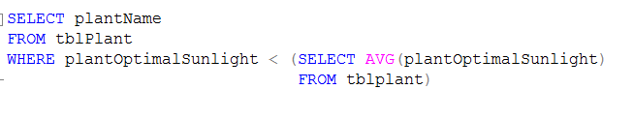
Subqueries in the WHERE
Comparing against an aggregate
Find all plants that need less than average sunlight
Notes:
What if I asked you to find the average yourself?
You can do that, yes?
So, to do the whole thing in one step, you can take the “find the average” query, and stick it in where you had the .38 before...
Note the parentheses. They are required around any subquery.

Slide 10
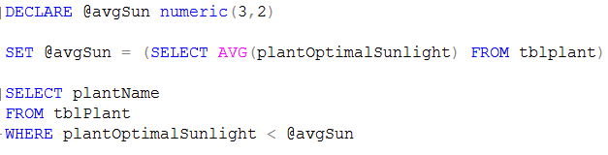
Subqueries in the WHERE
Comparing against an aggregate
Find all plants that need less than average sunlight
Notes:
Note that you can also do this – it will give you the correct answer
However, this is poor SQL practice.
This is essentially forcing SQL to behave like a procedural language – do this, then do this, then do this
SQL and its underlying parser and compiler aren’t set up for this, and the execution of it will be much less efficient than will the corresponding “natural SQL” method where you work with sets.
We will be looking at query efficiency next week, and you will see that orders of magnitude performance differences are possible depending on how you write your queries.
When writing complex SQL, you must let go of your procedural programming mindset. Don’t tell the computer how to do it; tell it what result you want

Slide 11
Aggregate in the WHERE
Books
catno title author publisher category
C100 Physics Handbook Jones Wiley Physics
C200 Simply the Best Advacaat Rangers Football
C300 Database Design Wilson McCall Computing
C400 Business Society Neal Wiley Business
C500 The Metro Abbey Wiley Leisure
C600 Graphics Sedge Maxwell Computing
C700 Cell Biology Norton West Biology
Loans
catno memno borrowed date_ret fine
C100 M100 12/09/01 20/09/01 NULL
C300 M100 01/09/01 NULL NULL
C400 M200 04/06/01 16/09/01 £16.30
C500 M200 04/08/01 16/09/01 £16.30
C600 M250 02/10/01 24/10/01 £30.00
C700 M300 10/09/01 19/10/01 NULL
Members
memno name address age
M100 Fred Aberdeen 22
M150 Colin Stirling 31
M200 Dave Dundee 21
M250 Betty Aberdeen 67
M300 Jean Dundee 17
Notes:
Consider this little database (give handout). It represents a little library. There is a members table, and books table and a loans table, which is the many-to-many linking table showing who has checked out which books.
We will be using this for some examples for the rest of the lecture.

Slide 12
Aggregate in the WHERE
Who is the oldest member of the library?
Logically:
SELECT name
FROM members
WHERE age = maximum age
Solution
SELECT name
FROM Members
WHERE age = (SELECT MAX(age)
FROM Members)
Notes:
As before, if I told you the maximum age, or if you had computed it yourself in advance so you knew it was 67, you would just stuff it in the expression.
How would you compute it? With a MAX(age) query
So, just pop the needed query right into the place where it says “maximum age”

Slide 13
Other Subqueries in the WHERE
Testing against a set
IN tests for membership
ANY tests for value
ALL tests for value
EXISTS tests for existence
Notes:
The aggregate examples, you will have noticed, return a single value
We test them in the WHERE clause with value = or value > or whatever.
In some cases, though, we want to test a logical predicate that involves a whole set of values. Does the set contain our comparator? Do all members of the set exceed our comparator? Is there anything in the set at all? And so on.
There are four special operators in SQL that work with sets returned by subqueries.
They can occur in other situations as well (for example, we use IN a lot without subqueries), but this is an important role for them

Slide 14
Subqueries with IN
We have seen IN before:
SELECT name
FROM owners
WHERE petType IN (‘rabbit’, ‘horse’)
Notes:
We use IN when we want to test for set membership
We have seen it in many situations, like these here
But what if we don’t know the set in advance?
What if the membership of the comparison set is some value that can only be determined at runtime, like “the countries who won gold medals in the last Olympics”?
No problem, we replace the hard-coded set membership with the appropriate SELECT

Slide 15
Subqueries with IN
Plant ID | Plant Name | Optimal Sunlight Percentage
0 | Carrot | .26
1 | Beet | .44
2 | Corn | .44
3 | Tomato | .42
4 | Radish | .28
Assume I tell you that plantID {1, 3, 4, 5} all have sowing events with more than 28 seeds.
Write a query to list the names of all plants having sowing events with more than 28 seeds.
SELECT plantName
FROM tblPlant
WHERE plantID IN (1,3,4,5)
Notes:
Remember these tables (I’ve deleted some columns to make them fit better on the screen)
This is easy using IN

Slide 16
Subqueries with IN
How did I know which plantID values should go in that set?
Plant ID | Technician ID | Location ID | Seed Count
0 | 0 | 0 | 28
0 | 1 | 1 | 14
1 | 0 | 2 | 36
2 | 1 | 3 | 20
2 | 2 | 2 | 12
3 | 3 | 3 | 38
4 | 2 | 0 | 30
SELECT plantID FROM tblSowing
WHERE seedCount > 28
Notes:
You’ll need the sowing table
And again, the query is easy to write.
So, as before, SQL will allow you to combine these two queries

Slide 17
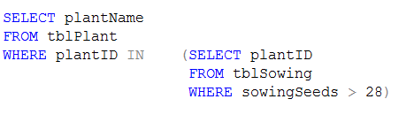
Subqueries with IN
List the names of all plants that had a sowing of more than 28 seeds

Slide 18
Subqueries with IN
List the library books that have been borrowed (by anyone)
SELECT title
FROM tblBooks
WHERE catNo IN
(SELECT catNo
FROM loans)
Notes:
Refer to handout
In the loans table, you can see which books have been borrowed by looking at the catalogue numbers
So this query needs to list all titles whose catalogue numbers appear in the loans table
How would you find those? (inner query)
And then what? (outer query)

Slide 19
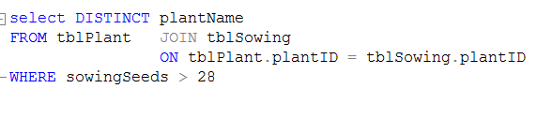
Subqueries with IN
Alternative:
List the names of all plants that had a sowing of more than 28 seeds
Notes:
As with any complex language, there are generally many different ways to achieve the same result in SQL
Remember this query?
Can you do it without a subquery?
Most, but not all queries that you can write with a subquery can also be written with a join
There are technical advantages and disadvantages to both approaches, and we will discuss them, especially when we talk about performance tuning next week
However, you need to be able to understand both, so you will be prepared for any legacy code they hit you with.

Slide 20
Subqueries with ANY & ALL
The IN operator essentially tests “is the comparison value = to some member of this set”
The ANY and ALL operators allow you to test inequalities:
Is the comparison value greater than ANY element in this set?
Is the comparison value less than ALL elements in this set?

Slide 21
Subqueries with ANY & ALL
tblProduct ( productName, price, category, maker)
List the products that cost more than all products made by “Acme”
Logically:
SELECT productName
FROM tblProduct
WHERE price > ALL (prices of ACME products)
Notes:
Assume this relation: Product ( pname, price, category, maker).
This is a rather flat table; in a real database it would probably be broken into several relations, but we’ll use this for simplicity…
In there, we need to get all the prices of ACME products.
That is a set, and can be produced by a simple query.
You can write that query?

Slide 22
Subqueries with ANY & ALL
SELECT productName
FROM tblProduct
WHERE price > ALL (SELECT price
FROM tblProduct
WHERE maker = ‘Acme’)

Slide 23
Subqueries with ANY & ALL
SELECT plantID
FROM tblHarvest
WHERE harvestCount <= ALL
(SELECT harvestCount
FROM tblHarvest)
Notes:
What does this query do?
It returns the plantID from the record whose harvestCount is less than or equal to all the other harvest counts, that is, the smallest.
Is there an alternative? Yes, WHERE harvestCount < (SELECT MIN(harvestCount.....)

Slide 24
Subqueries with ANY & ALL
SELECT plantName
FROM tblPlant
WHERE plantOptimalSunlight >= ALL
(SELECT plantOptimalSunlight
FROM tblPlant)
Notes:
What do you think this query does?
It returns the name of the plant(s) that needs the most sunlight.

Slide 25
Subqueries with ANY & ALL
SELECT plantName
FROM tblPlant
WHERE plantOptimalSunlight > ANY
(SELECT plantOptimalSunlight
FROM tblPlant)
Notes:
What do you think this query does?
It returns the names of all the plants EXCEPT the one that needs the LEAST sunlight.
Select plant if it is greater than any value in the set
This term is ambiguous in English, and so to clarify this, the latest standard of SQL has introduced SOME as an alternative to ANY.
It is exactly the same, just a different word.

Slide 26
Subqueries with ANY & ALL
SELECT plantName
FROM tblPlant
WHERE plantOptimalSunlight > SOME
(SELECT plantOptimalSunlight
FROM tblPlant)
Notes:
What do you think this query does?
It returns the names of all the plants EXCEPT the one that needs the LEAST sunlight.
Select plant if it is greater than any value in the set
This term is ambiguous in English, and so to clarify this, the latest standard of SQL has introduced SOME as an alternative to ANY.
It is exactly the same, just a different word.

Slide 27
Subqueries with EXIST
Find all the books that have ever been borrowed.
If a book has been borrowed, its catNo will be in the Loans table.
If we know the catNo, we can find the title from the books table.
For a given catNo, we only care if it is in the set drawn from the Loans table, so we can use EXIST
Notes:
In some cases, when we talk about wanting to compare to a set, we don’t really care about the actual values in it, just whether there are any at all.
For example, we might want all the books that have ever been borrowed, or all the plants that have ever been sown
Refer to your handout. By looking, how can you tell which books have been borrowed? They are the ones whose catNo is in at least one record of the loans table.

Slide 28
Subqueries with EXIST
SELECT title
FROM tblBooks
WHERE EXISTS (SELECT catNo
FROM Loans)
Notes:
What does this do? (not what we want)
First, the inner query returns all the catalog numbers from Loans
Then, for each record in tblBooks, it asks “does this inner query return anything?”
And, in every case, it answers “Yes”.
So, this query returns every book in tblBooks, regardless of whether they’ve been loaned or not.

Slide 29
Subqueries with EXIST
SELECT title
FROM tblBooks
WHERE EXISTS (SELECT catNo
FROM Loans
WHERE catNo = ???)
Notes:
What we really want here is not “do any catalogue numbers exist in the loans table”
we want FOR EACH RECORD of tblBooks “does this particular catalogue number exist in the loans table”
We want to say “the catNo of the current record of tblBooks”. So we need to be able to refer back to tblBooks
Let’s try calling it by name...

Slide 30
Subqueries with EXIST
SELECT title
FROM tblBooks
WHERE EXISTS (SELECT catNo
FROM Loans
WHERE catNo = tblBooks.catNo)
Msg 4104, Level 16, State 1, Line 11
The multi-part identifier " tblBooks.catNo " could not be bound.
Notes:
What we really want here is not “do any catalogue numbers exist in the loans table”
we want FOR EACH RECORD of tblBooks “does this particular catalogue number exist in the loans table”
We want to say “the catNo of the current record of tblBooks”. So we need to be able to refer back to tblBooks
Let’s try calling it by name...
Nope, no good. The parser can’t work out what you mean.
The first catNo means “this record in Loans”, just like always.
Which catNo in tblBooks are you talking about? It can’t tell.
You need to signal that you’re talking about the record from the outer query.
The method for doing this in SQL is to name the table instance in the outer query and use that name in the inner query.
Like this...

Slide 31
Subqueries with EXIST
SELECT title
FROM tblBooks b
WHERE EXISTS (SELECT catNo
FROM Loans
WHERE catNo = b.catNo)
Notes:
This use of aliasing tells the parser:
Walk through tblBooks (alias b)
For each record, execute this inner query, using the current record of tblBooks
Use the result of that inner query to evaluate the WHERE condition of the outer query
So, for each book, find all records in Loans where catNo = catNo of the current outer record
If that set is not empty (EXISTS evaluates to true), return that title

Slide 32

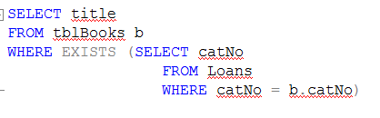
Correlated vs Uncorrelated Subqueries
Notes:
Uncorrelated.
The inner query has a single result
It is evaluated once, and needs to know nothing about the outer query
Correlated
The inner query depends on which record of the outer query you are working on
The inner query references the outer query table, and must be executed once for each record of the outer query
Correlated queries are powerful, but can be inefficient. Can you see why?
O(n**2) runtime

Slide 33
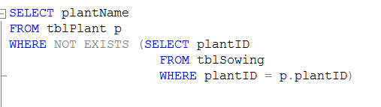
Subqueries with Exists
EXISTS can be negated with NOT
Notes:
What does this query do?
Returns all plants that have never been planted

Slide 34
Subqueries
May occur as a substatement of another query:
In the WHERE clause
In the HAVING clause
In the FROM clause
In the SELECT list
Notes:
Recall that we started with this statement
We have looked at subqueries in the WHERE, and seen that they allow you to compare against an aggregate or a set of values returned by an inner SELECT statement.
this is the most common use of a subquery.
Second most common is in the HAVING

Slide 35
Subqueries in the HAVING clause
Review:
SELECT plantID, SUM(harvestCount)
FROM tblHarvest
GROUP BY plantID
Notes:
Brief review: What does this query do?
Lists all the plantIDs, along with the sum of harvestCount for every record with that plantID in tblHarvest

Slide 36
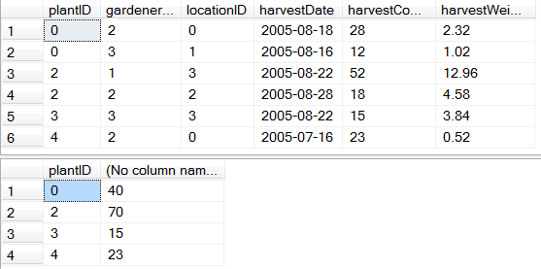
Subqueries in the HAVING clause
Notes:
Here’s the whole table, and the result of the query.
Ok. Remember all this?

Slide 37
Subqueries in the HAVING clause
SELECT plantID, SUM(harvestCount)
FROM tblHarvest
WHERE SUM(harvestCount) >= 40
GROUP BY plantID
Msg 147, Level 15, State 1, Line 12
An aggregate may not appear in the WHERE clause unless it is in a subquery contained in a HAVING clause or a select list, and the column being aggregated is an outer reference.
Notes:
What does this do?
This spits.
You can’t use the aggregate in the WHERE clause.
This makes sense, actually. To compute the SUMs, the system must know which records to group together. Thus it must select and group all its records before computing any sums.
Thus all WHERE and GROUP statements are executed before the associated aggregate statements.
Therefore, no WHERE statement can refer to the result of an aggregate.
Keep in mind that SQL is not procedural: our code doesn’t say “do this first, do this second....”
Remember how to do this? (Hint: slide title)

Slide 38
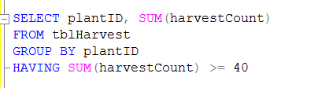

Subqueries in the HAVING clause

Slide 39
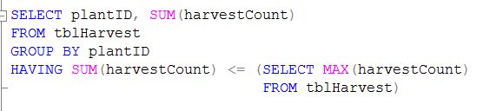
Subqueries in the HAVING clause
List the plants whose total harvest was less than the largest single harvest.
Notes:
We have established that sometimes the WHERE clause needs a set of records to evaluate, and that requires an embedded SELECT (i.e. a subquery)
This is also true of the HAVING clause

Slide 40
Subqueries in the FROM clause
SELECT column, column, column
FROM table, table, table
Notes:
This is how SELECT works. Various columns from various tables
But what if the column you want doesn’t actually exist in any of your tables?
Sometimes, you can compute it, if it is just math on an existing column, but sometimes you can’t
For example, if you want to display an aggregate across a set of records, that’s not an expression, that’s a query.
This is the most common use of a subquery in FROM – when you want to display a column that depends on a record set

Slide 41
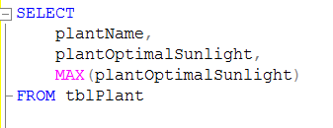
Subqueries in the FROM clause
List each plant’s name, optimal sunlight and the maximum optimal sunlight, for comparison.
Attempt 1:
Notes:
Doesn’t run:
Msg 8120, Level 16, State 1, Line 3
Column 'tblPlant.plantName is invalid in the select list because it is not contained in either an aggregate function or the GROUP BY clause.
SQL thinks you’ve asked it to compute the MAX across some set, but it doesn’t know what set you mean, since you also want it to show you an individual plantName and name on each row.
You will recall that if there is an aggregate function, every element in a SELECT list that is not in an aggregate function must be in the GROUP clause
So we could try grouping them...

Slide 42
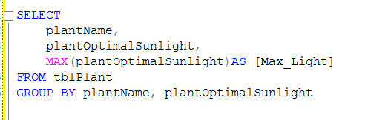
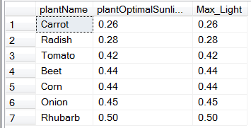
Subqueries in the FROM clause
Attempt 2:
Notes:
This runs. What does it return?
Well, you said GROUP by name and sunlight value.
So, for each combination of name and sunlight, it collapsed and took the max
That is, for each individual row, it collapsed and took the max
Not what we want.
We want the max of all the records.
That is a set function, so needs a subquery
Here’s how to do it right...

Slide 43
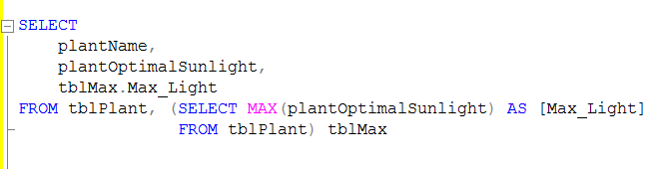
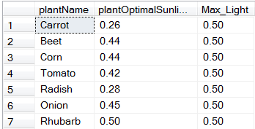
Subqueries in the FROM clause
Attempt 3:
Notes:
A couple of things to note here:
The subquery creates a table on the fly, from which you can select a column
You give the table an alias (tblMax) and use that alias to reference columns of the derived table
The derived table must be aliased, whether you reference it in the rest of the code or not

Slide 44
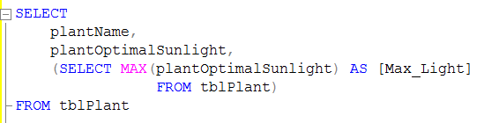
Subqueries in the SELECT list
Attempt 4:
Notes:
And finally, you can slap this subquery right into the SELECT list.
Works just the same

Slide 45
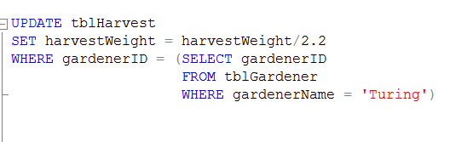
Subqueries in UPDATE & DELETE
Essentially, you can use a subquery wherever you can use an expression
Notes:
What does this query do?
Changes the weight field to pounds for all Turing’s entries

Slide 46
Nested subqueries
List the names of all members who have borrowed a business or computing book.
Logically:
Get the catalogue numbers of business and computing books
Get the member numbers of everyone who has one of those catalogue numbers in their loan records
Get the name associated with those member numbers
Notes:
And subqueries can themselves contain subqueries, recursively.
This query requires all three tables – members to get the name, books to look for the type and loans to link them together.
We work from the innermost query out...

Slide 47
Nested subqueries
Get the catalogue numbers of business and computing books
SELECT catNo FROM tblBooks
WHERE category IN (‘business’, ‘computing’)
Notes:
This query requires all three tables – members to get the name, books to look for the type and loans to link them together.
We work from the innermost query out...

Slide 48
Nested subqueries
Get the member numbers of everyone who has one of those catalogue numbers in their loan records
SELECT DISTINCT memNo
FROM tblLoans
WHERE catno IN (SELECT catNo
FROM tblBooks
WHERE category IN (‘business’, ‘computing’))
Notes:
We’ve just used the subquery

Slide 49
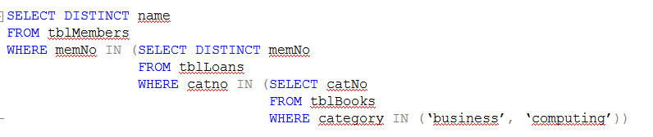
Nested subqueries
Get the name associated with those member numbers
Notes:
Ignore the red lines....
The parser is quite happy with this.
Can you write this same query another way, with no subqueries?

Slide 50
Alternative
List the names of all members who have borrowed a business or computing book
SELECT DISTINCT name
FROM tblMembers m JOIN tblLoans l ON m.memNo = l.memNo
JOIN tblBooks b ON b.catNo = l.catNo
WHERE b.category IN (‘business’, ‘computing’)
Notes:
Which is correct? (Both)
How are they performed by the machine? (The same)
Which do you like better?

Slide 51
Complex Subqueries
SELECT d1.state, st.stor_name, d1.TotalSales, [store rank] = COUNT(*)
FROM (SELECT t.state, t.stor_id, SUM(s.qty) AS TotalSales
FROM sales s JOIN stores t ON (s.stor_id = t.stor_id)
GROUP BY t.state, t.stor_id) d1
JOIN
(SELECT t.state, t.stor_id, SUM(s.qty) AS TotalSales
FROM sales s JOIN stores t ON (s.stor_id = t.stor_id)
GROUP BY t.state, t.stor_id) d2
ON (d1.state=d2.state)
JOIN stores st on d1.stor_id = st.stor_id
WHERE d1.TotalSales <= d2.TotalSales -- to get the rank
GROUP BY d1.state, st.stor_name, d1.TotalSales
HAVING COUNT(*) <= 1
ORDER BY d1.state, [store rank]
Notes:
This query demonstrates that there are some things that SQL simply isn’t suited to, and you should just write the code in an appropriate language.
-- Return the store with the top sales in each state
Note that the original was actually worse, with the derived tables that are aliased as d1 and d2 below actually called s and t (like the inner aliases) and apparently relying on scoping to eliminate confusion.
Full credit for clever, but it’s really rather silly. Would you like to get that as legacy code?
-- Here the derived tables are created on the fly in the FROM
-- This derived table is built twice and self-joined. In each case
-- we select state and stor_id from stores and sum(qty) from sales
-- joining on stor_id. From the self-join we select on col1 < col2
-- to allow this self-join counting thing that Henderson likes
-- we then join that cross join with stores

Slide 52
Exercises

